Slide 1
PROJECT VIVA PRESENTATION
Daily sales analysis of a cafe to increase efficiency and Net Profit
Student Name
Student ID
Business
Course
Vedaant Arora
24DS3000056
COFFEE BEANS
BUSINESS DATA MANAGEMENT

Slide 2
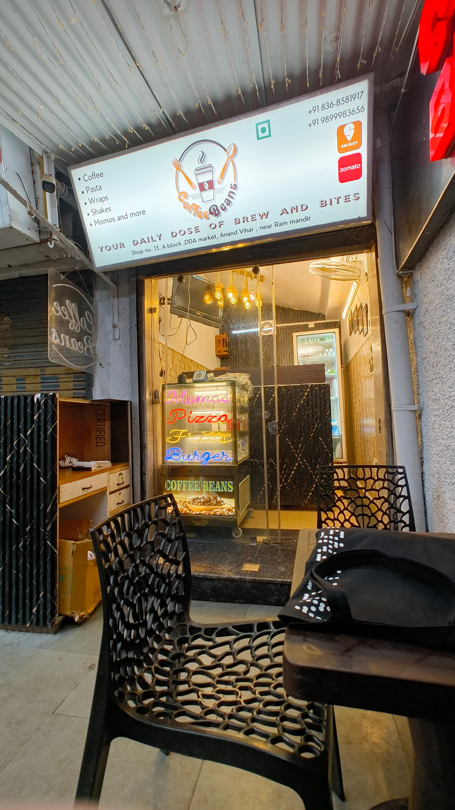
PROJECT OVERVIEW
About the Business
Business Type
A local cafe serving customers with food and beverages like pizza, Burgers, Coffee, Shakes and etc. They sell through walk in customers and delivery.
Location
Shop number 13, A block, DDA Market, Anand Vihar, Delhi, India
Study Duration
135 days of operational data captured over a 150-day period (15 days closed/unrecorded).
Problem Faced By Onwer
The owner of the cafe has been in the restaurant industry for quite a few years but the cafe has remained vulnerable to unpredicatable expenditure spikes. This project addresses the problem where sudden cost surges dissolve profits. This unpredictability needs a more analytical approach to stabilize the business.

Slide 3
IDENTIFIED CHALLENGES
Problem Statement & Objectives
Problem Statements
Unpredictable Sales
Unexplored cost inefficiencies
01
Daily revenue fluctuates heavily, making it difficult to forecast income or plan raw material purchases efficiently
02
Expense records exist but have never been analyzed, so unnecessary spending goes unidentified and uncontrolled.
Objectives
Identify Sales Patterns
Track Expense Behavior
01
Determine which days consistently perform better to enable smarter stock purchasing and reduce wastage.
02
Compare daily expenses against sales to pinpoint where avoidable costs are occurring.
Improve Profit Margins
Enable Data-Driven Decisions
03
Provide data-backed suggestions to cut costs and increase net profit without risking shortages or overstocking.
04
Shift the owner's decision-making from intuition to actual sales and expense trends.

Slide 4
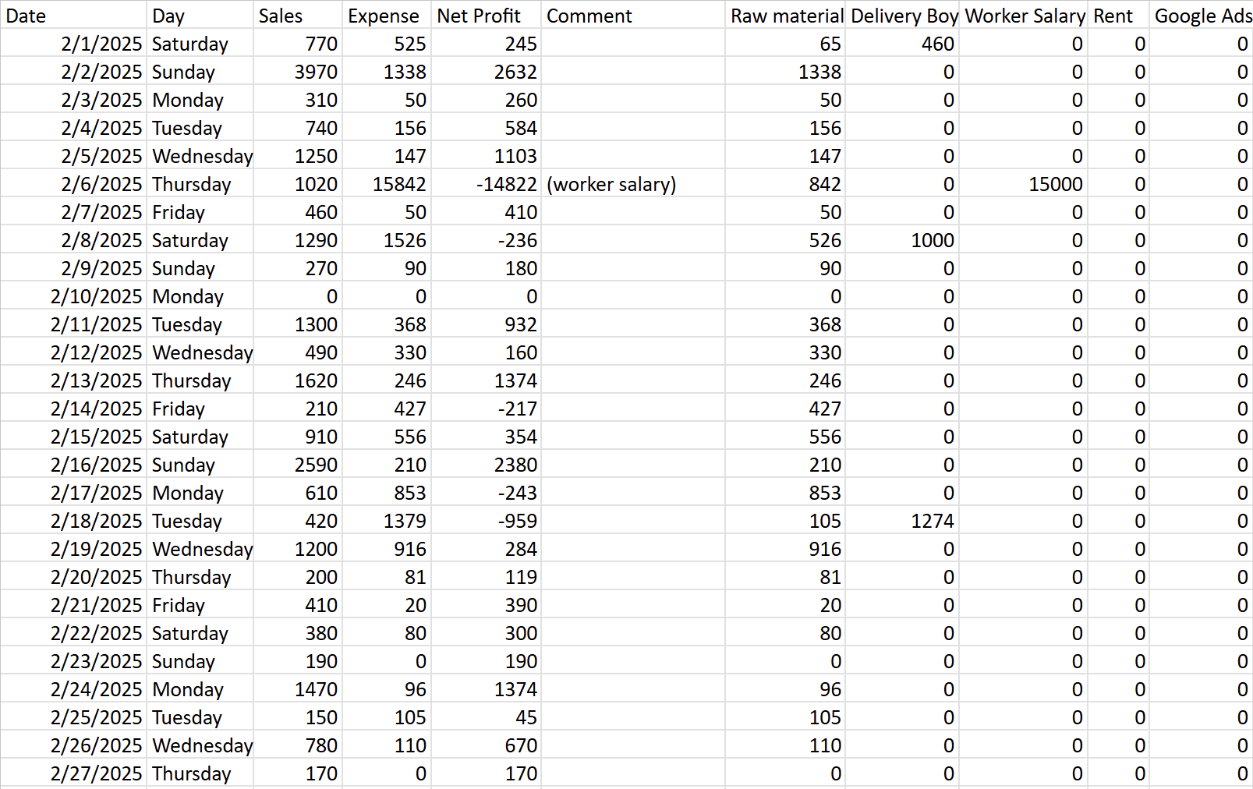
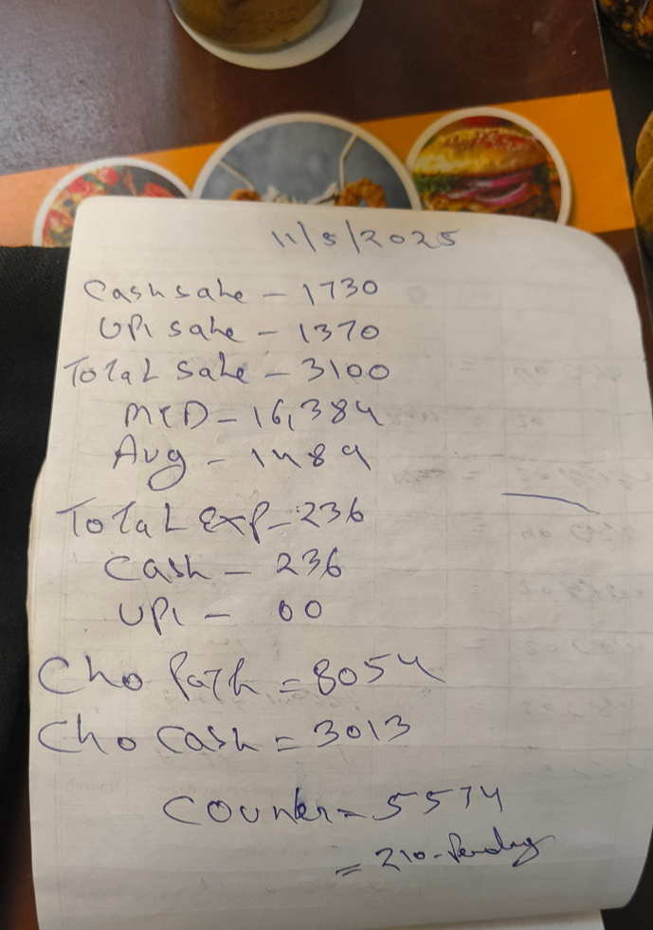
DATASET OVERVIEW
About the Data
DATA COLUMNS
RAW DATA IMAGE
SOURCE
Daily sales and expense records maintained manually by the owner
COLLECTION METHOD
Data was hand-recorded in a bill book by the shop owner each day. I took photos of the bill book and digitized it into a structured Excel sheet.
TIME PERIOD
1st February 2025 to 30th June 2025. 150 days of observations.
6 Columns , 150 row, February-June 2025

Slide 5
DATA PREPARATION
Data Cleaning
Converted Sales, Expense and Net Profit columns to numeric. Any non-numeric entries were converted to NaN.
12 rows had null values in Sales and Expense. Combined with rows where both were recorded as zero, 17 days total were dropped as closure days.
Defined an Operating Day as any day where Sales or Expense was greater than zero — this gave 133 usable days out of 150.
Comment column had 131 missing entries, it wasn't used for analysis, only to understand outliers like salary and rent spike days.
Net Profit was verified as Sales − Expense across all rows and relabeled from "Profit" to "Net Profit" for accuracy.
Five expense category columns (Raw Material, Delivery Boy, Worker Salary, Rent, Google Ads) were added from bill book records but they were only partially filled, so aggregate Expense was kept as the primary variable.

Slide 6
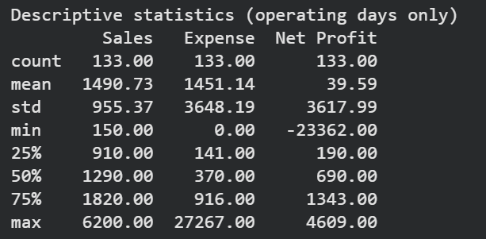
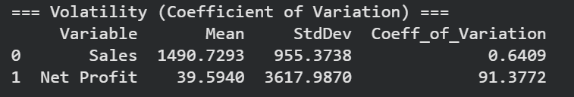
SUMMARY MEASURES
Descriptive Statistics
Average daily net profit was just ₹39.59 despite average sales of ₹1,490
Expense median is ₹370 but the mean is ₹1,451, spike days pull the average up by 4x
Sales fluctuate, but within a range that is manageable and somewhat predictable. A CV of 0.64 means the standard deviation is 64% of average sales, which is moderate for a small café with no fixed customer base. Net profit tells a completely different story. A CV of 91.38 means the standard deviation is 91 times the average profit. The reason is simple, the average profit is so thin that even one bad expense day completely distorts it. This gap between sales stability and profit instability is the core finding of the entire analysis.

Slide 7
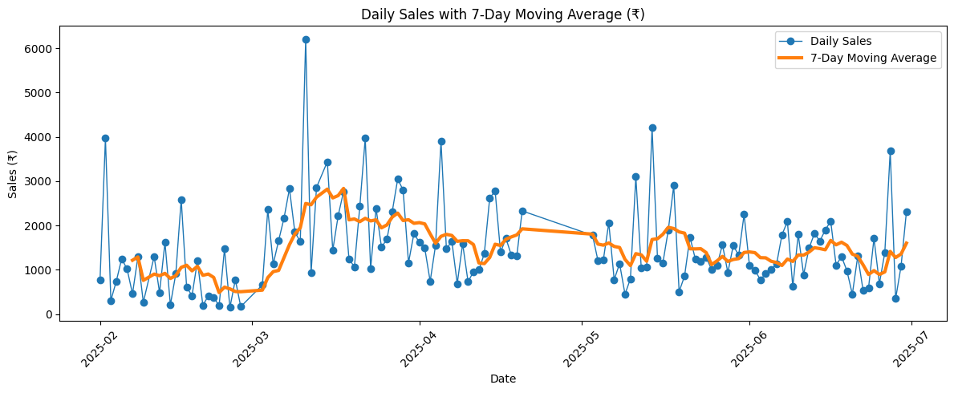
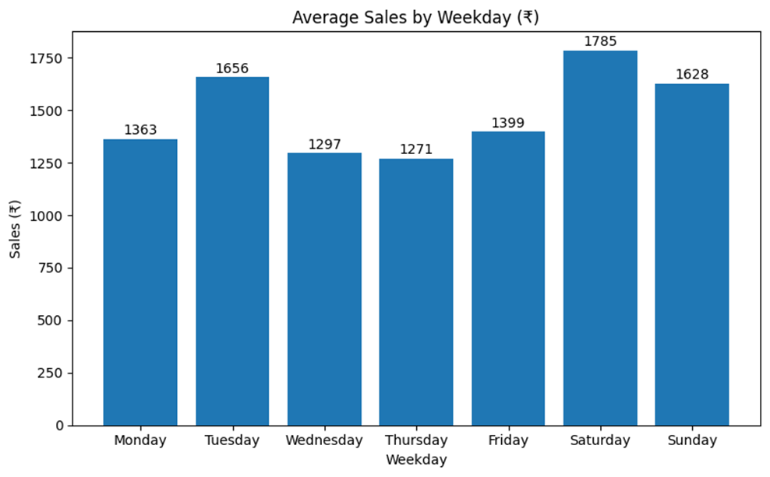
FINDINGS
Analysis & Graphs I
The daily sales line shows sharp spikes and sudden drops throughout the observation period, with no clear upward or downward trend. The 7-day moving average smooths out the noise and confirms that while demand exists, it is irregular and unpredictable. This makes it very difficult for the owner to forecast weekly or monthly income reliably.
Figure 1: Daily Sales and 7 day moving average
Saturday records the highest average sales at ₹1,785, while Wednesday and Thursday are the weakest days at ₹1,297 and ₹1,271 respectively. This uneven distribution means customer footfall follows a weekly pattern, which should inform decisions around inventory procurement and staffing levels.
Figure 2: Average sales by weekday

Slide 8
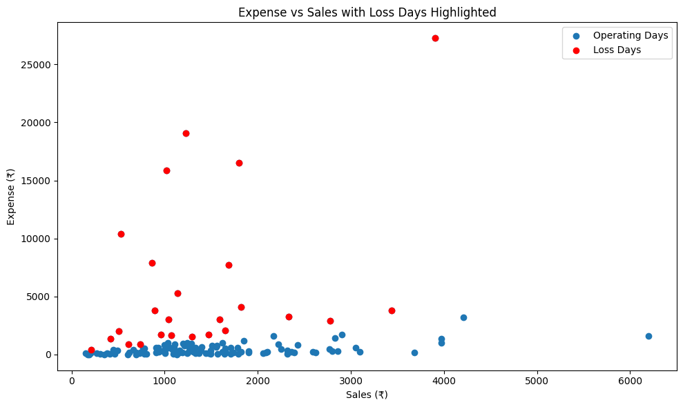
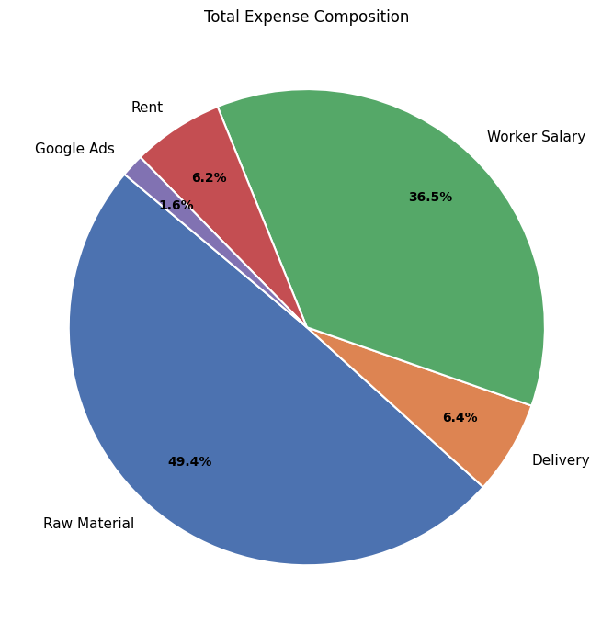
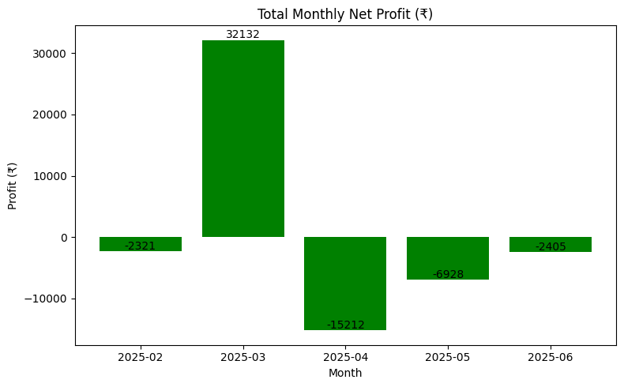
FINDINGS
Analysis & Graphs II
Figure 3: Expense vs Sales with Loss Days
Figure 4: Expense Composition Pie Chart
Figure 5: Monthly Net Profit Distribution
Each point represents one operating day. Blue for profitable days and red for loss days. The red points are not clustered at low sales values. Instead, many sit high on the expense axis at moderate sales levels. This confirms that losses are driven by expense spikes rather than weak demand. The largest spike on 5th April (₹27,267 in expenses) was caused by rent and salary being paid on the same day.
Raw materials make up 49.4% of total expenses, representing the regular day to day cost of operations. Worker salary is the second largest at 36.5%, but unlike raw materials, salary payments were concentrated on only 10 out of 133 operating days.
March is the only month with a positive total net profit of ₹32,132. Every other month recorded losses, with April being the worst at −₹15,212. This shows that a few extreme expense days are enough to wipe out an entire month's earnings, and that the instability is not just daily but carries over to the monthly level.

Slide 9
ACTIONABLE TAKEAWAYS
Insights & Recommendations
1
Align Procurement with High-Demand Days
2
Re-evaluate Weekend Cost Behaviour
Friday has the highest average net profit despite not being the top sales day. Bulk purchases should be timed around strong demand windows.
Saturday has the highest sales but records negative average net profit. The gap between revenue and profit on that day points to overstaffing, excess inventory or wastage that needs to be reviewed specifically.
3
Introduce a Daily Expense Ceiling
4
Focus on Loss Magnitude, Not Loss Frequency
If daily sales fall below the historical median, discretionary spending should be cut. If sales exceed break-even early, additional procurement is safer. Adaptive spending instead of fixed patterns.
The café is profitable on 81.2% of days. This tells that while losses happen on about 1 in every 5 days. The problem is that the losses are massive. I recommend to identify top 5 loss days each month and understand what drove expense higher on those days.

Slide 10
Future Work
Limitations & Conclusion
Limitations
Conclusion
Item-level sales data was not available consistently, making it impossible to identify which products drive revenue or margin
Expense category breakdown was missing for over 50% of operating days, so aggregate expense had to be used as the primary variable
External factors like weather, holidays and local events affected footfall but could not be captured or isolated in the data
The observation period covers the café's early stage, where one-time setup costs like equipment and initial stock inflate certain expense days
Manual hand-recording by the owner introduces the possibility of human error and inconsistency across entries
The café is profitable on 81.2% of operating days, the problem is not demand, it is how costs are timed and managed
A handful of extreme expense days, primarily driven by lump-sum salary and rent payments, are responsible for wiping out monthly earnings
March was the only month with a positive total net profit. Every other month recorded a loss despite reasonable daily sales
The gap between a sales CV of 0.64 and a profit CV of 91.38 confirms that instability lives entirely on the cost side
With better expense timing, demand-aligned procurement and basic monthly tracking, consistent profitability is achievable for this business
Business Data Management — Project Viva
Thank You

